Slide 1
Fusion Artificial Intelligence Data Platform
30/01/2026

Slide 2
01 | What is FAIDP
02 | FAIDP in the Oracle Landscape
03 | New FDI Features
04 | Maximising OAC Value
05 | Advanced Self-Service

Slide 3
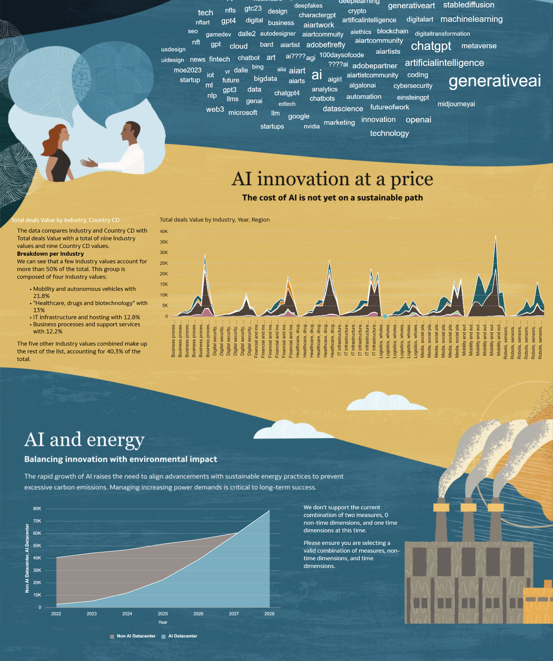
What is the FAIDP?
Combining Fusion Data Intelligence and the Artificial Intelligence Data Platform

Slide 4
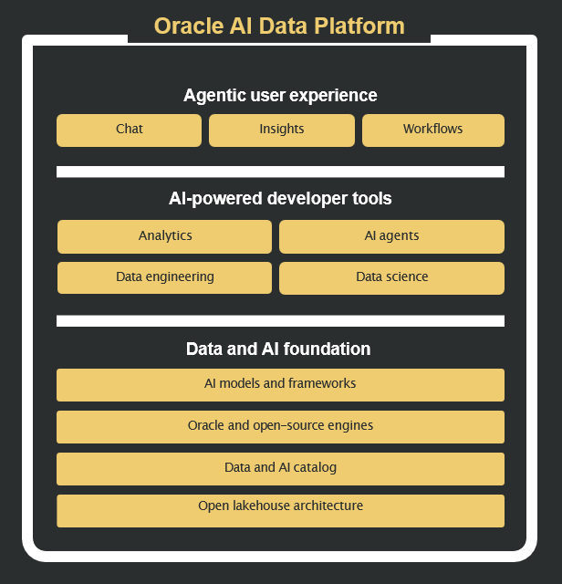
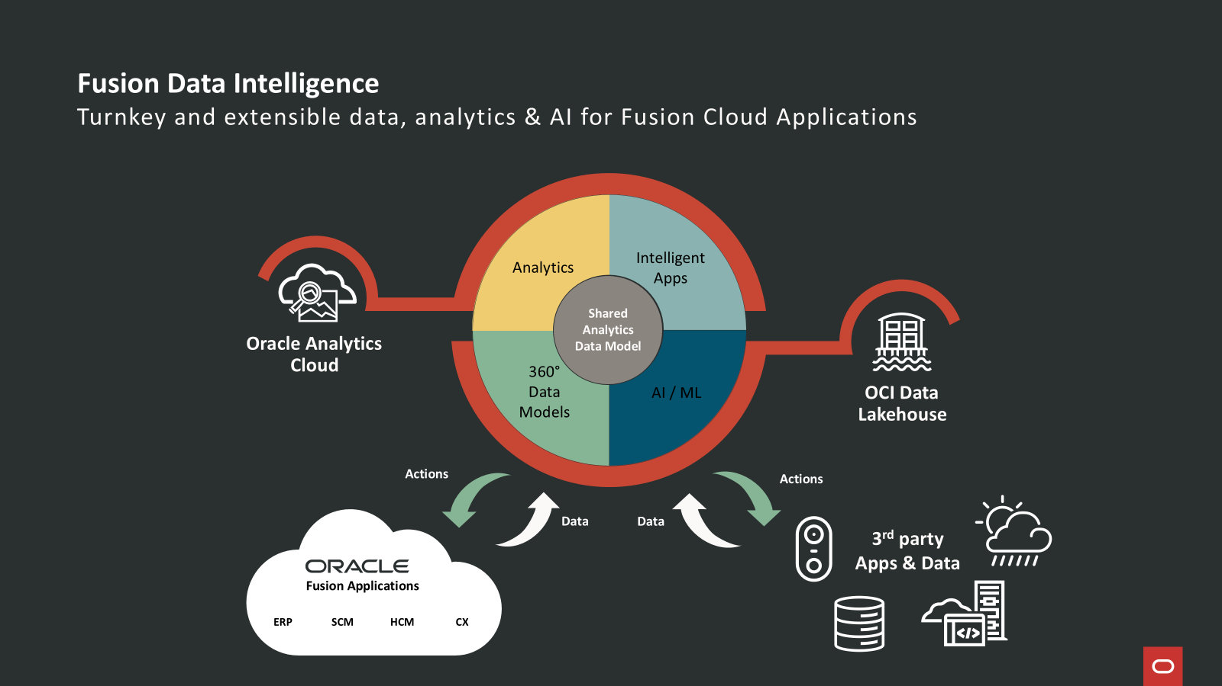
Introducing the Fusion Artificial Data Intelligence Platform
Empowering Meaningful Actions
FAIDP combines Fusion Data Intelligence and the Artificial Intelligence Data Platform
Extends FDI capabilities by providing a powerful AI engine for getting deeper insights, recommending actions and processing AI Agents

Slide 5
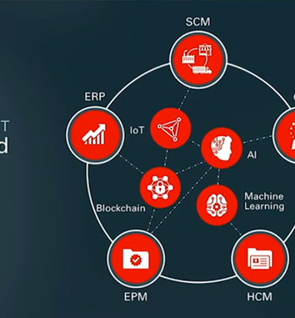
FAIDP in the Oracle Ecosystem

Slide 6








Reporting & Analytics in Oracle Cloud
RUN
The business
GUIDE
The business
Transactional Staff
LoB Managers
Business Partners
Analysts
Heads of Business
Executives
Real Time
Trans-action Detail
Daily Updates
Trend Analysis
Scenario Modelling
AI/ML Driven Analysis
Multi Source Analysis
Holistic View in one Place
Transactional Reporting
(OTBI)
Planning & Performance Mgmt.
(EPM)
Analytics
(Fusion Data Intelligence)
WHAT is happening?
WHERE are my bottlenecks?
WHERE do we want to be?
WHAT has happened?
HOW do I execute my Strategy?
WHICH way are things trending?
WHAT do I need to do today?
HOW compliant are we?
WHY have things happened?
Actionable Insight for ALL Roles | Maximising Value of Fusion Applications
Notes:
Oracle Cloud transforms the way you think about data.
If we think about the broad purposes of Reporting and data analysis, we can separate them into 2 areas and Oracle Cloud provides the tools you need across all the use cases in this spectrum.
<CLICK>
On the left hand side for running the business, we have transactional reporting tools such as Transactional Bus

Slide 7


Analytics
Enterprise Performance Management
Embedded Analysis / OTBI
Notes:
When you go on holiday, we can liken the tools to driving a car. The transactional reports would be the speedometer, looking at what is going on now. EPM would be the sat nav, constantly looking ahead and re-planning the route. Finally, everything else in front of you and behind would be the Analytics experience, taking account of all the factors to make informed decisions

Slide 8
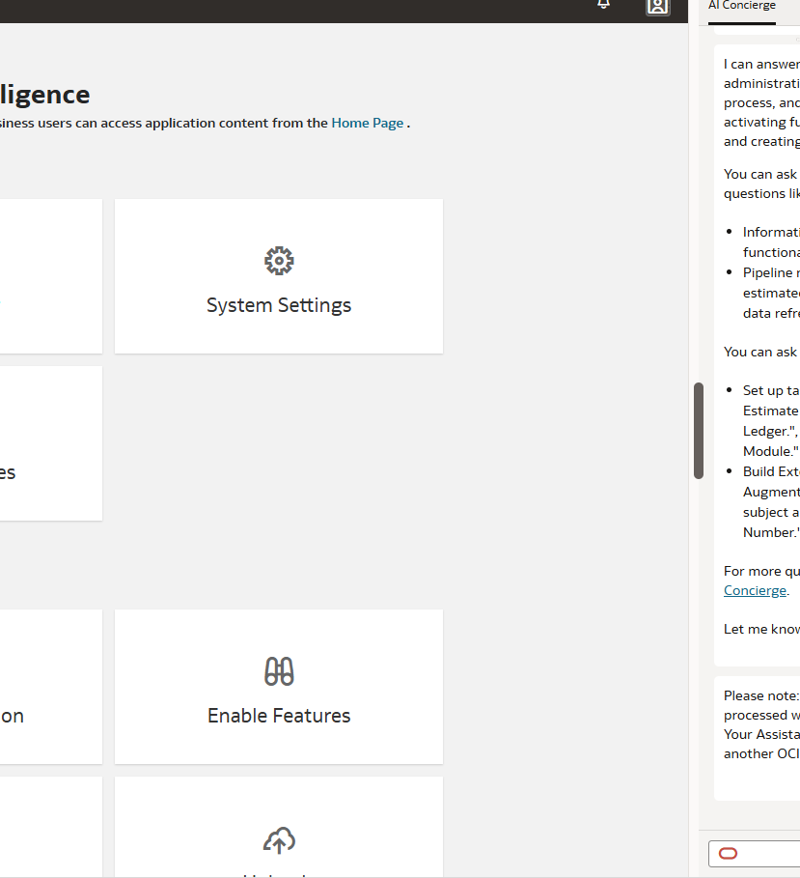
New FDI & OAC Features

Slide 9
New features in FDI
Highlights
AI Concierge – Enables developers to use AI to carry out admin tasks
LLM Integration – Enables OAC Digital Assistant
Automated AOR Security
Frequent Data Refresh V2
Multiple Home-Pages
Column Selectors
Natural Language Search
New visualisation types

Slide 10
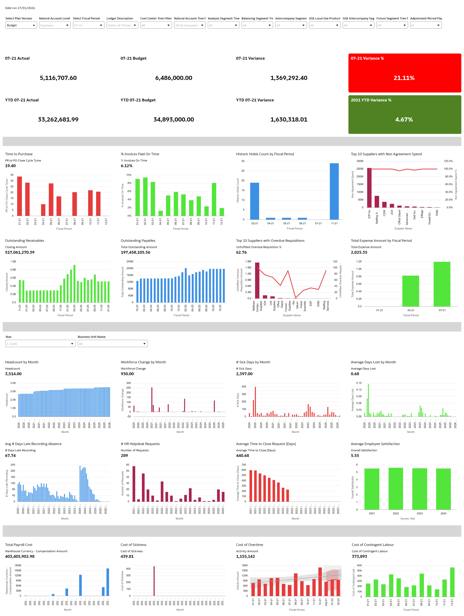
Maximising OAC Value

Slide 11
Features to maximise OAC Value
Parameters - What-if Analysis Using Parameters in Oracle Analytics
Data Actions – Drill to other analysis or back to Fusion transaction
Cross-functional/persona-based workbooks
Digital Assistant
Workbook Check-up – Recommendations to boost workbook efficiency
Watchlists and end user customisations

Slide 12
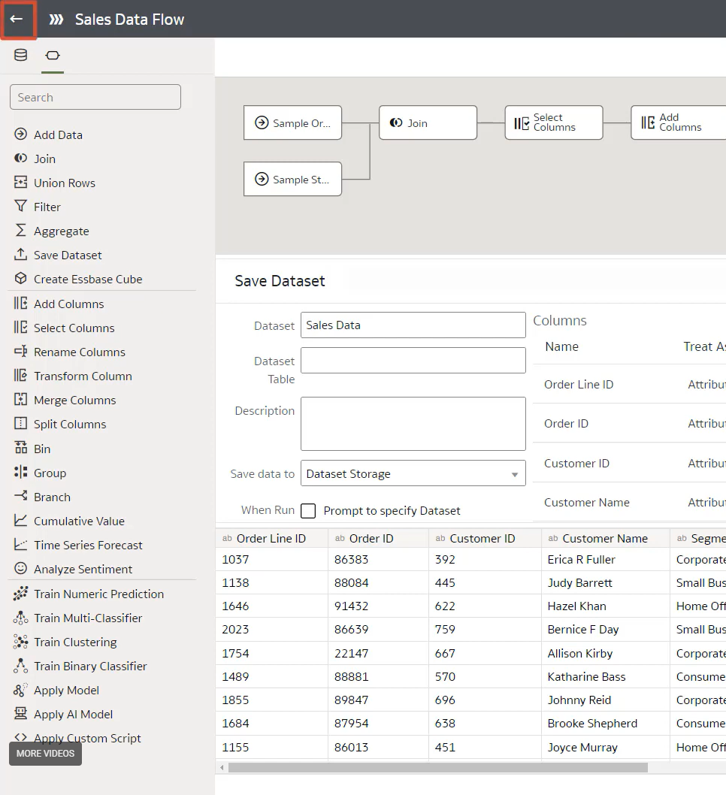
Advanced Self-Service

Slide 13
Advanced Self-Service
The What and When
OAC has advanced self-service capabilities, enabling users to upload or connect to their own data and create data flows, incorporating machine learning
This should be considered self-service only and is not best practice for ‘governed analytics’ that is meant for wide consumption
It is often used as a proof of concept before formal delivery
Data Flow Video - https://www.youtube.com/watch?v=ig5Lbx6sn5U
Sentiment Analysis - How to leverage Sentiment Analysis ML in Oracle Analytics Cloud | by Bill magkourilos | Jan, 2026 | Medium

